Slide 1



UNIT 3: School
Me and my school

Slide 2
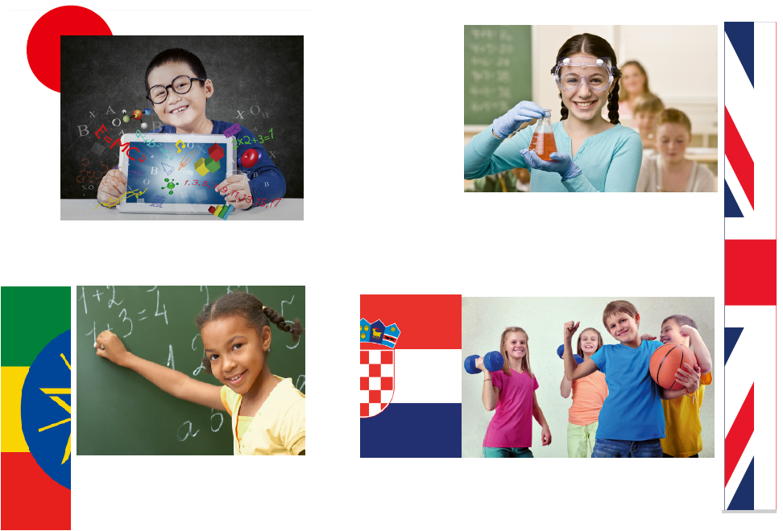
There is a symbol of a specific country next to each photo.
Can you guess which countries are represented?
The UK
Japan
Ethiopia
Croatia

Slide 3
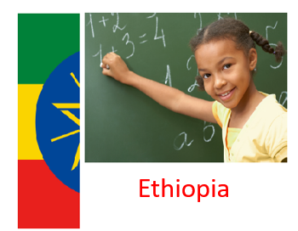
What do you know about Ethiopia?
Have you ever been there?
Watch the video and write down what you can see.
https://www.youtube.com/watch?v=i3Cg2O4MPfs

Slide 4
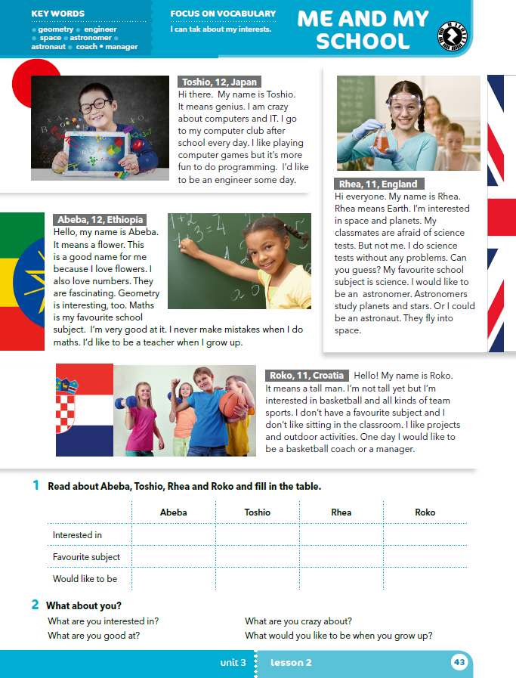
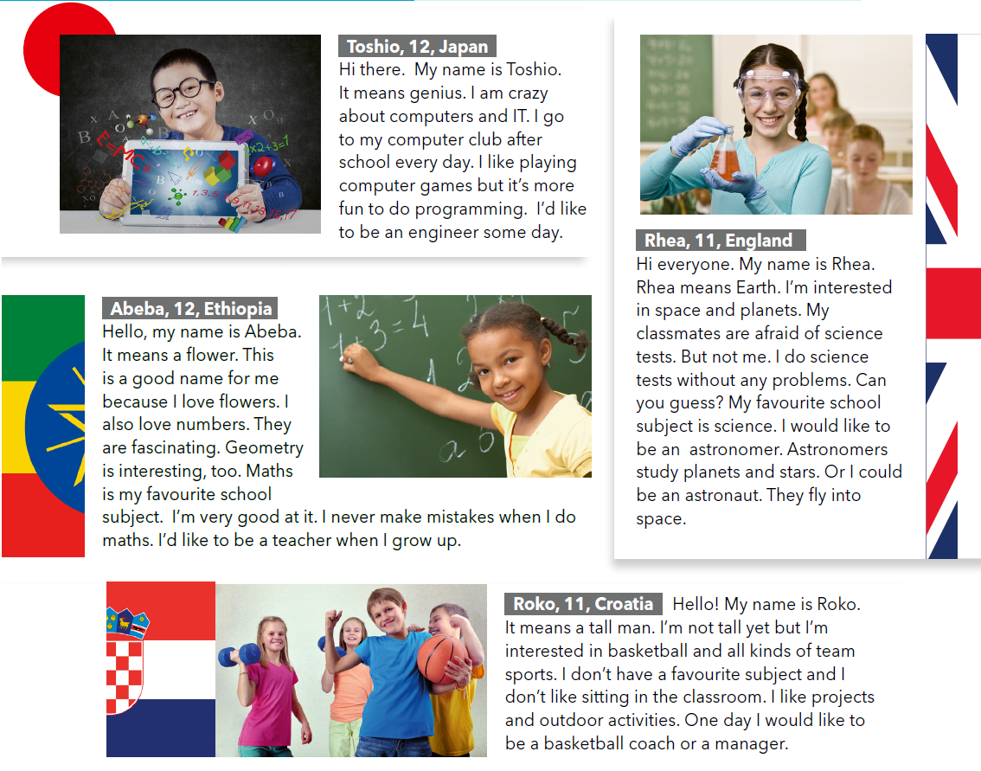
What are the children’s names?
Where are they from?

Slide 5
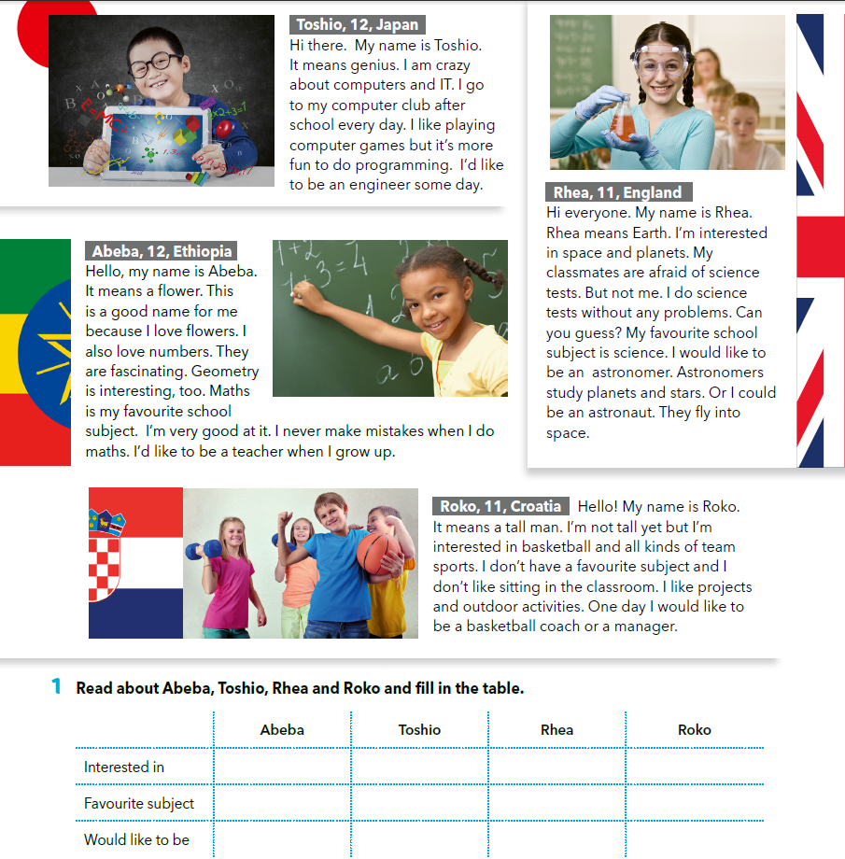
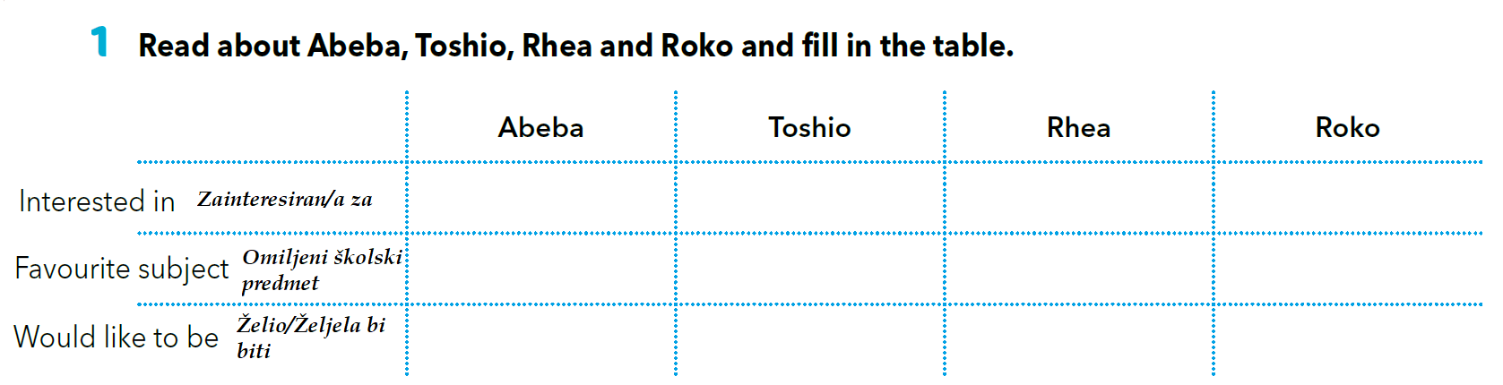
Read the texts and fill in the table.
computers, programming
basketball,
team sports
space, planets
flowers, numbers
maths
IT
science
/
a teacher
an engineer
an astronomer
a basketball coach or a manager

Slide 6
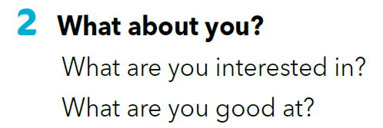
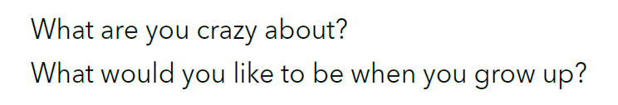

Slide 7
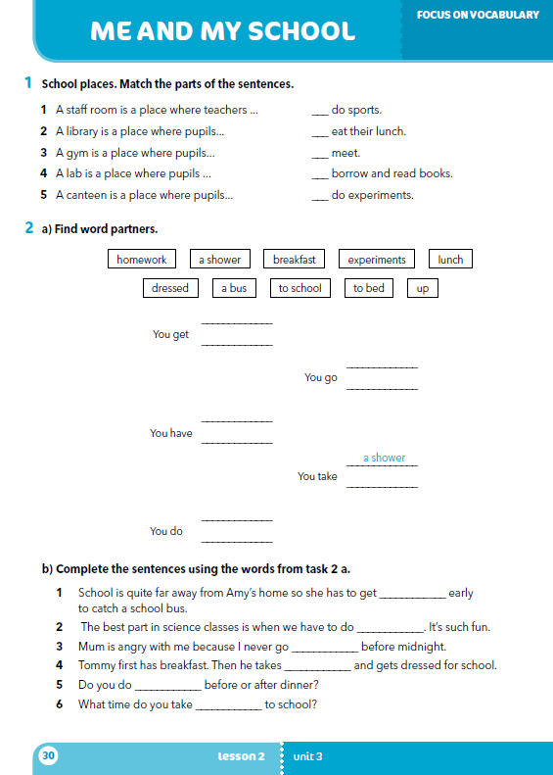
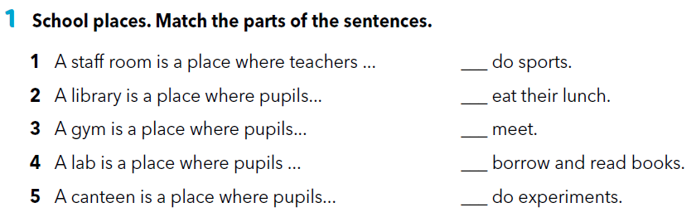
Workbook p 30.
3
5
1
2
4

Slide 8
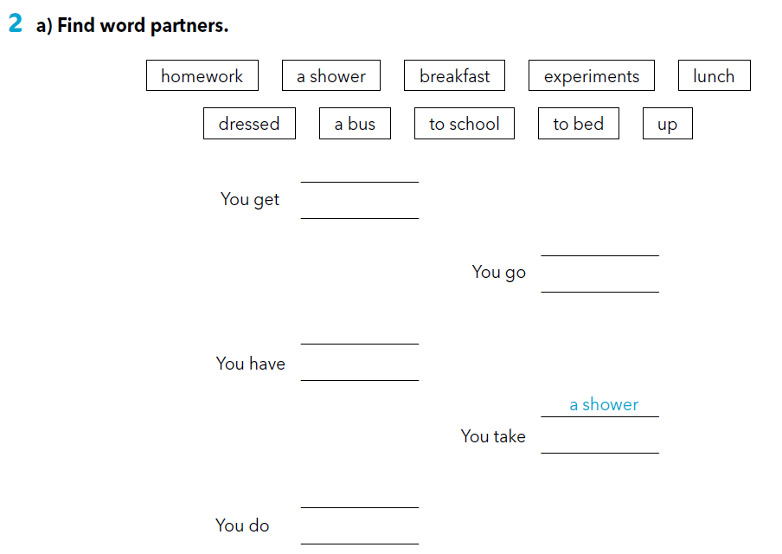
dressed
up
to school
to bed
breakfast
lunch
a bus
homework
experiments

Slide 9
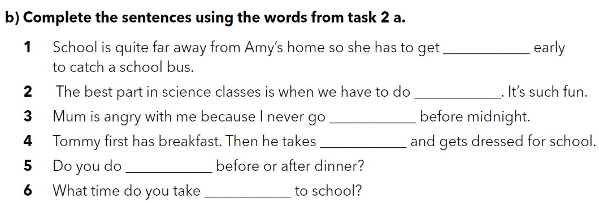
up
experiments
to bed
a shower
homework
bus

Slide 10

LEARN MORE.
https://www.e-sfera.hr/dodatni-digitalni-sadrzaji/898c1b9a-37e7-4f27-a13c-4ffaedc68d33/
Famous people at school
The best teacher
Read the texts and complete the tasks.

Slide 11
SELF CHECK
https://www.e-sfera.hr/dodatni-digitalni-sadrzaji/898c1b9a-37e7-4f27-a13c-4ffaedc68d33/

